Slide 1
The Effect of voter identification laws on voter turnout and democratic party victories
Scarlett Winters
Loyola University Chicago

Slide 2
Overview
Background
Hypothesis
Data analysis
Results
Research limitations
Where do we go from here?

Slide 3
background
The Help America Vote Act of 2002, born out of fear of voter fraud, assisted states in implementing voter identification laws. Many of these laws required some form of identification in order to vote,
Since 2002, 32 states have implemented laws requiring some form of identification before citizens can vote (Underhill 2016).
Voter identification laws have become more contentious, especially in light of the U.S. Supreme Court case Crawford v. Marion County Election Board (2008). Here, the Court validated Indiana’s voter identification law while opponents argued such a law disenfranchised minorities and lower-income citizens who cannot afford valid forms of identification.

Slide 4
Background
Proponents of strict voter identification laws argue they defend against voter fraud and strengthen the legitimacy of our democratic process. This increased efficacy actually improves turnout rates (Ansolabehere 2007; Mulhausen & Sikich 2007; Milyo 2007).
Opponents argue strict voter identification laws disenfranchise prospective voters who cannot afford legitimate forms of identification. (Barreto et al. 2009; Sobel & Smith 2009; Vercellotti & Anderson 2006; Hood & Bullock 2008). This disenfranchisement discourages voting and lowers turnout rates.

Slide 5
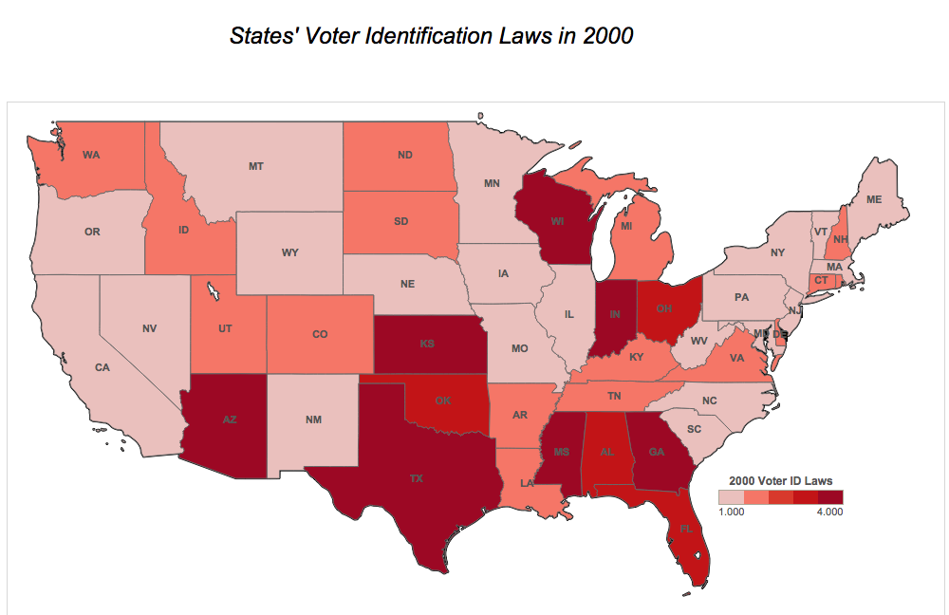
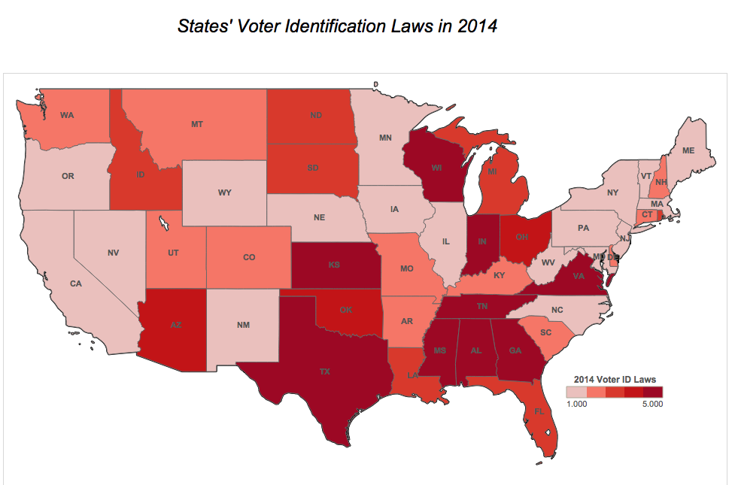
Change over time: Voter ID laws

Slide 6
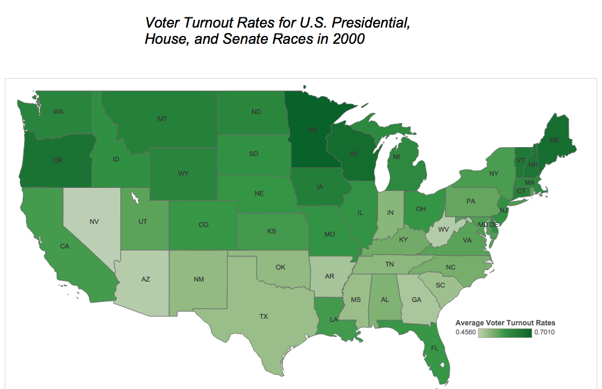
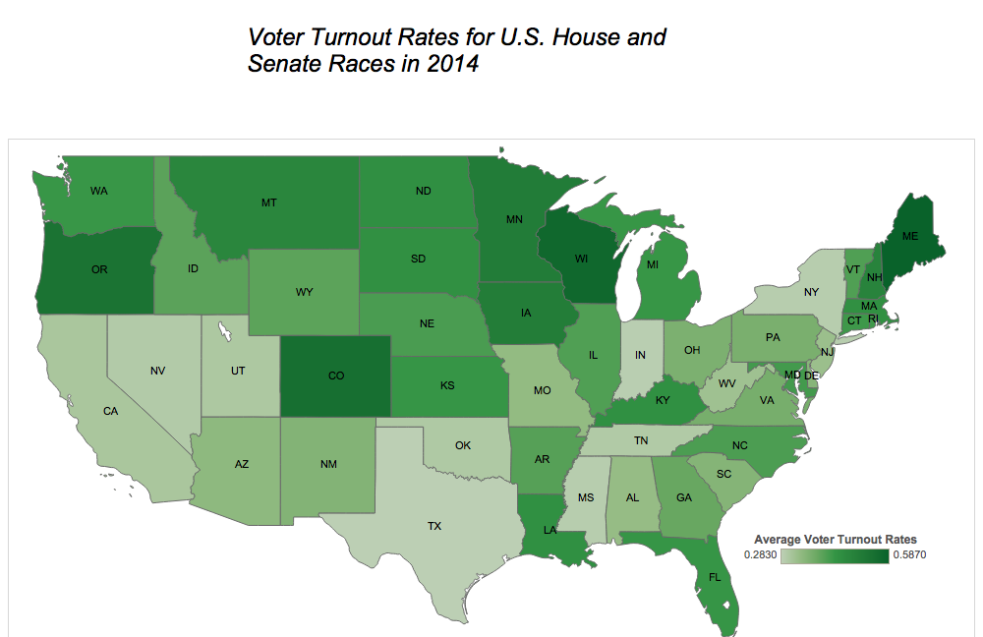
Change over time: voter turnout rates

Slide 7
Hypothesis
Despite the argument that voter identification laws disenfranchise minority voters, little research has been done on their impact on the Democratic party.
Historically, the Democratic Party holds the advantage over blacks and Hispanics. Compared to the Republican Party, “[t]he Democrats hold an 80%-11% advantage among blacks ... and by more than two-to-one among Hispanics (56%-26%)” (Doherty & Weisel 2015).
Hypothesis: Restrictive voter identification laws have a negative impact on voter turnout rates and Democratic party victories

Slide 8
The data
General and midterm turnout rates from 2000 – 2014 (all states excluding Washington, D.C.) (McDonald 2016)
Voter ID law restrictiveness, courtesy of the National Conference of State Legislatures (NCSL):
[1] No document required to vote; [2] ID requested, photo not required; [3] Photo ID requested; [4] Strict, non-photo ID; [5] Strict, photo ID required.
U.S. House and Senate race contentiousness (BallotPedia)
Percentage of voters who voted Democrat (U.S. House of Representatives)
Policy mood (Enns & Koch 2013)
Party of the incumbent president
Per-capita tax income (U.S. Census Bureau)
Early voting
Same day registration
Proportion of Democrats who won their seats (U.S. House of Representatives)

Slide 9
Why early voting?
Generally, early voting laws are viewed as beneficial for turnout efforts. However, research has shown early voting laws have either no measureable impact or a negative impact on turnout rates. (Primo, Jacobsmeier, and Milyo 2007; Fitzgerald 2005; Gronke et al. 2008; Burden et al. 2013).
Why?
Decreased cultural importance on Election Day itself
Procrastination
States with same-day registration implemented alongside early voting laws, however, increase turnout.
Burden, Canon, Mayer, and Moynihan (2013) describe same-day registration as essentially the “marriage” between election day registration and early voting since it allows voters to both register and vote on the same day.
Convenient for first-time voters.

Slide 10
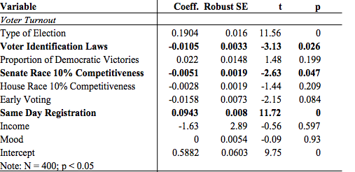
Results
Multivariate regression, voter turnout rates

Slide 11
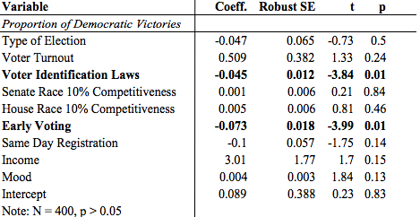
Results

Slide 12
Regression takeaways
Voter Turnout:
Impacted significantly by strength of voter ID laws (turnout ↓ 7%)
Senate races with 10% margin of competition or less (turnout ↓ 0.5%)
Same-day registration (turnout ↑ 9%)
Proportion of Democratic victories
Impacted by strength of voter identification laws (turnout ↓ 4%)
Early voting laws (turnout ↓ 7%)

Slide 13
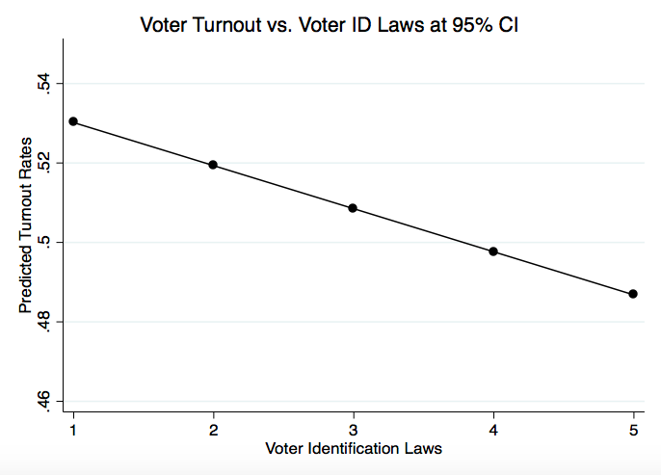
results
Prediction plot, voter turnout rates

Slide 14
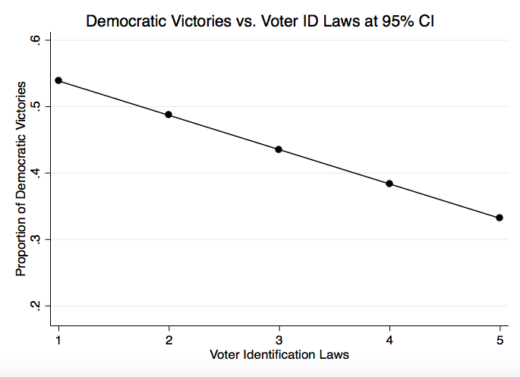

Slide 15
Prediction plot takeaways & Research limitations
Avg. turnout rate 53% when voter ID laws are least strict, decreases to 48.5% when voter ID laws are most strict
54% of Democrats win their seats in states with least restrictive laws, decreases to 33% in states with most restrictive laws
This was after controlling for state mood.
Extensive racial demographics and population change over time

Slide 16
What comes next?
Investigate why Senate race contentiousness may have a negative impact on turnout.
Incorporate detailed racial data into analyses
Account for population growth or decline over time

Slide 17
end

